Slide 1
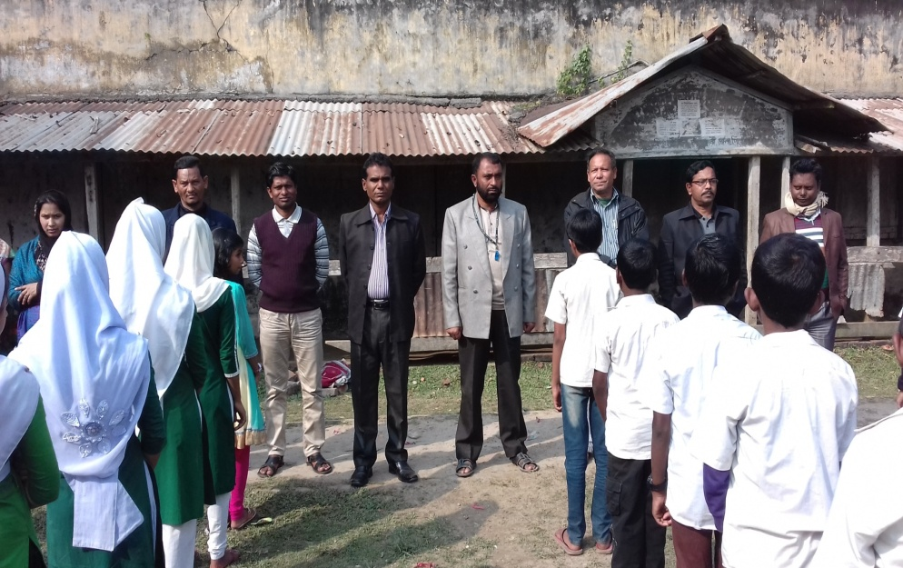
Welcome

Slide 2
I
D
E
N
T
I
T
Y
Teacher
Lesson
Md. Fourkan Uddin
Assistant Teacher
Kalaran.C.pur Ideal High School
Pirojpur.
English For Today
Class: Seven

Slide 3
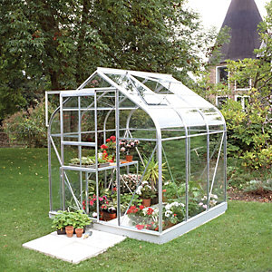
This is Greenhouse.
What is this?

Slide 4
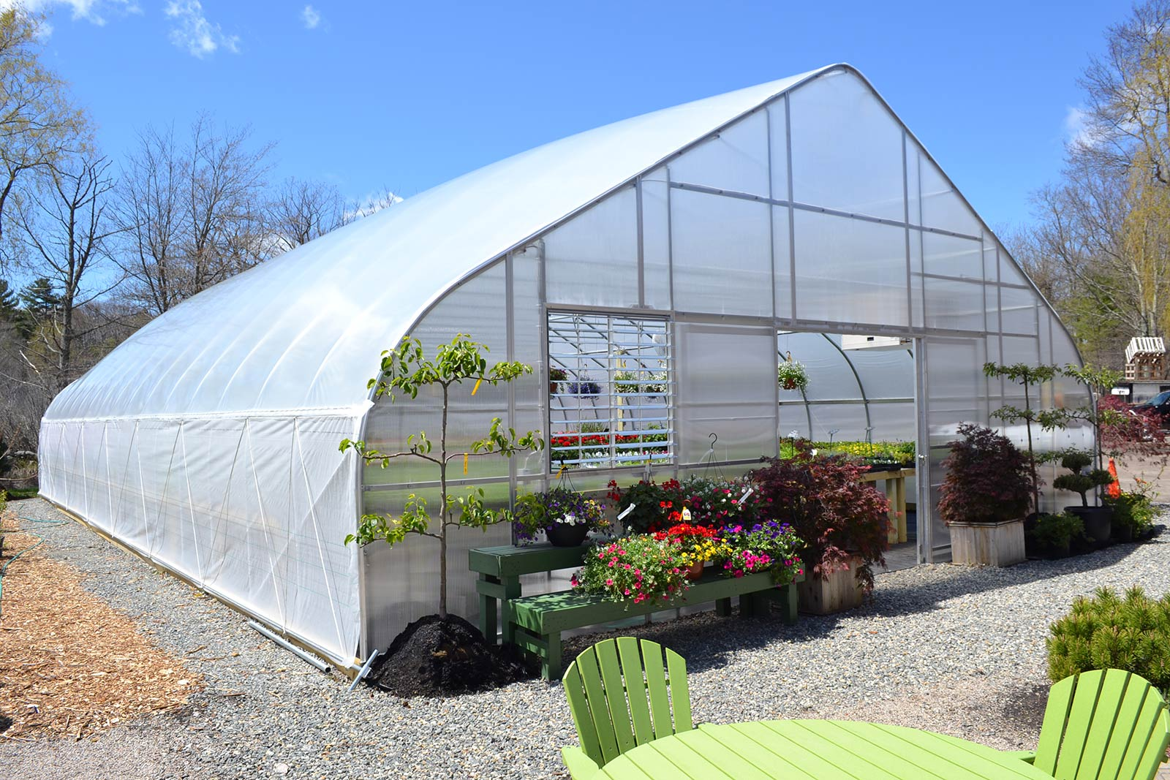
What is this?
This is a vegetable garden, in greenhouse.

Slide 5
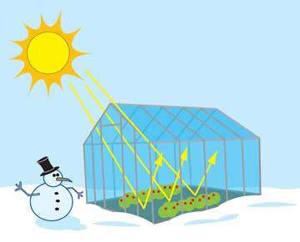
Title Declaration
So today our lesson is:
Unit: Nine, Lesson: Three
The Greenhouse effect

Slide 6
Learning Outcomes
After we have studied this unit, we will be able to
Read and understand texts
Talk about climate and environment
Ask and answer question
Write short paragraphs.
Write short guided and semi-guided sentences.

Slide 7
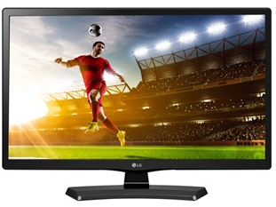
Let‘s enjoy the Video
Click here

Slide 8
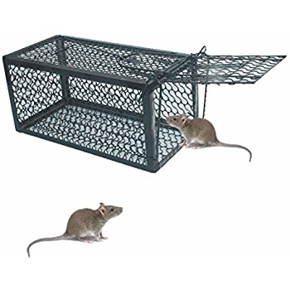
Key words
Trap
Meaning: a device or enclosure designed to catch animals.

Slide 9
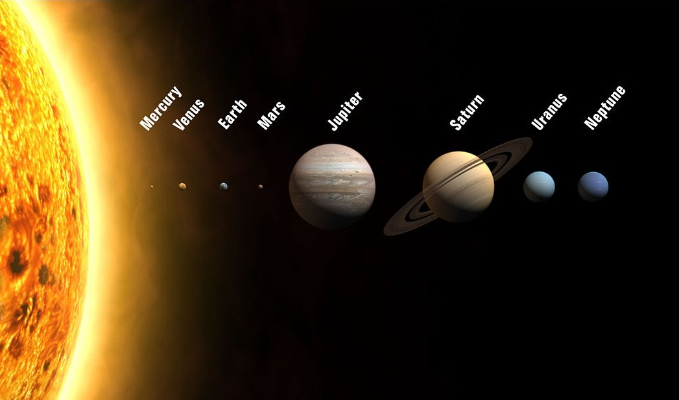
Key words
Planet
Meaning: a celestial body moving in an elliptical orbit around a star.

Slide 10
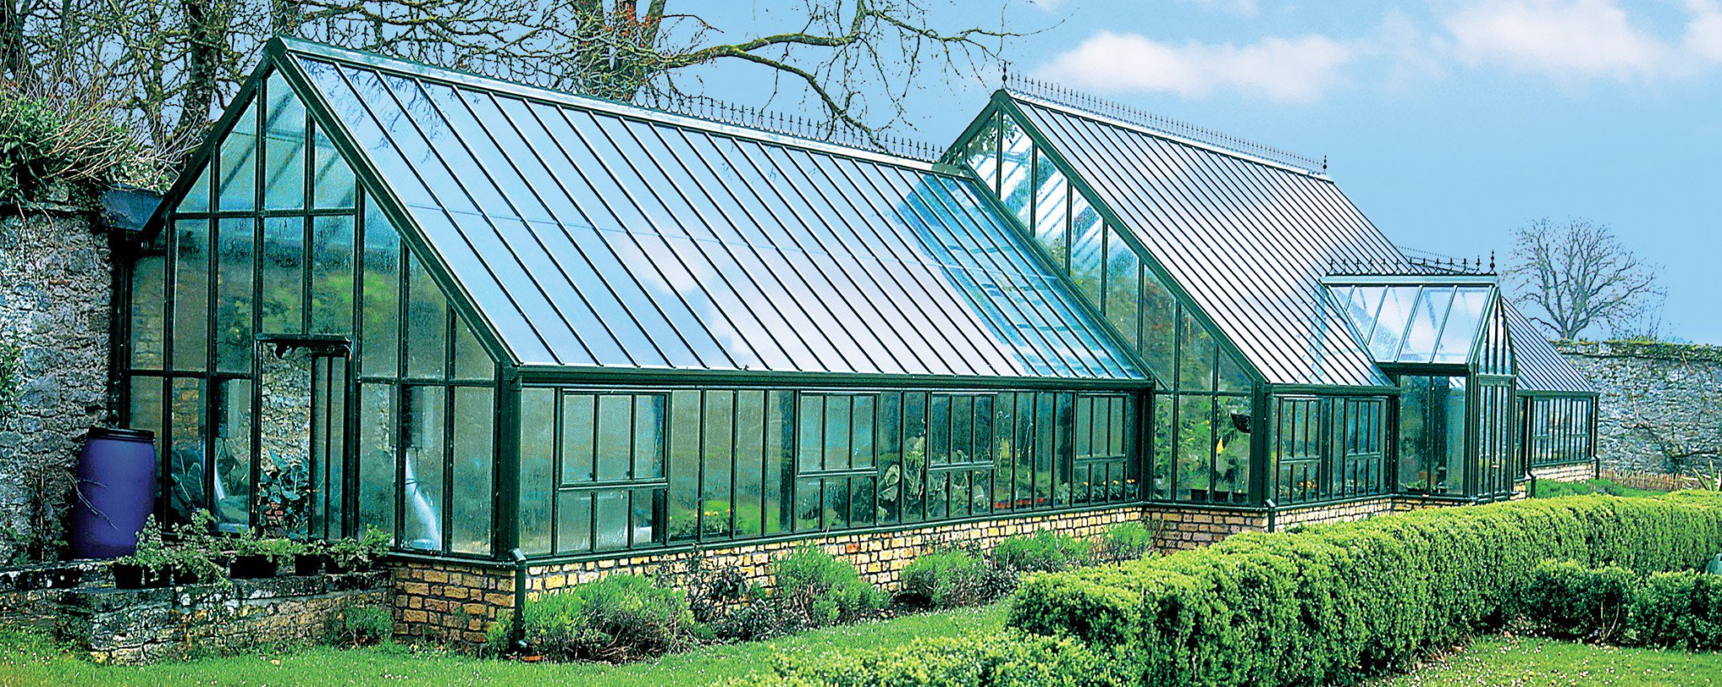
Key words
Greenhouse
Meaning: a glass building in which plants are grown.

Slide 11
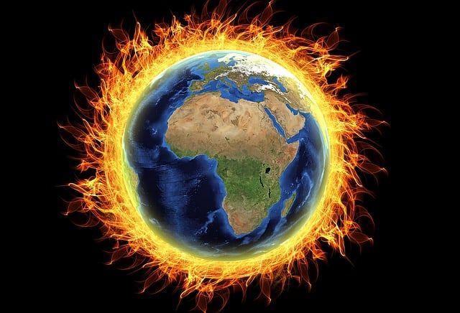
Key words
Global Warming
Meaning: a gradual increase in the overall temperature of the earth’s.

Slide 12
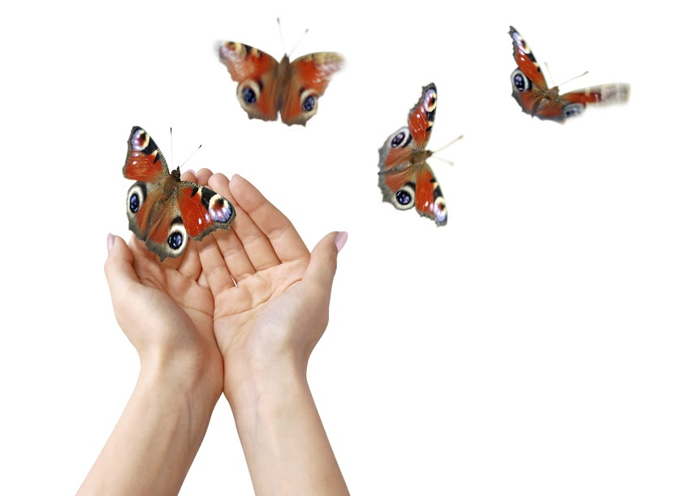
Key words
Released
Meaning: Open/Free

Slide 13
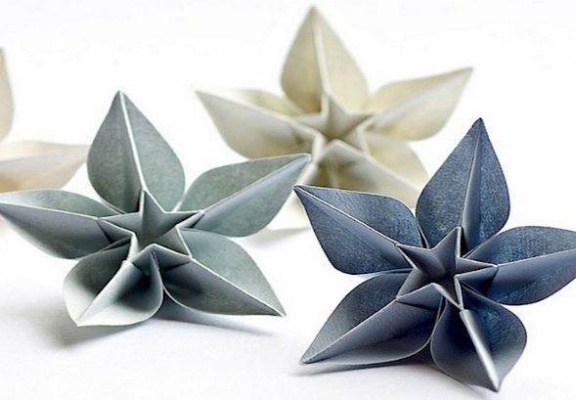
Teachers Model Reading
Keep silent and listen attentively

Slide 14
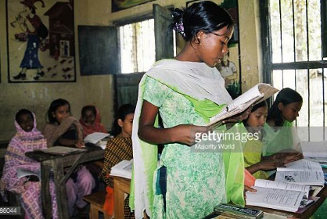
Student’s Model Reading
Read Loudly

Slide 15
Group Works
Change the underlined words to talk about the increasing threats of global warming.
A. The sun is hot.
B. The sun is becoming hotter.
A. The effects of global warming will be bad.
B. The effects of global warming will be worse than what we can imagine.
A. The sun keeps the earth warm during day time.
B. The sun makes the earth warmer.
A. The cyclones are powerful now.
B. The cyclones will be more powerful in future.
A. Our environment is already polluted.
B. Carbon dioxide gas makes the environment more polluted.

Slide 16
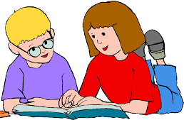
Pair Works
In pairs, discuss the questions below and write answers to them.
1. What is a greenhouse and how does it work?
Answer: Greenhouse is a house made up of glass and it traps the heat of the sun inside.
2. How is the earth’s atmosphere similar to a greenhouse?
Answer: The glass walls of the greenhouse capture the heat of the sun and keep the house warmer. This is because the heat received from the sun is trapped inside the greenhouse by the glass. That is why the earth is similar to a greenhouse.
3. Recently temperatures on Earth have been rising faster than normal. Why is it so?
Answer: We are using fuels and they carry carbon which traps the heat in the atmosphere not allowing the earth to cool down. So, temperatures on earth have been rising faster than normal.

Slide 17
Individual Works
Complete the following passage with the missing words given in the box.
gases | Carbon dioxide | fuels | machine | greenhouse | climate | heat | energy
greenhouse
Carbon dioxide, one of the gases, exists naturally in the atmosphere. It is also produced when humans use fuels such as coal, oil and gas. Cars, and factories all burn for , to make a car move or to make a machine generate electricity. This adds more to the atmosphere and makes a blanket of greenhouse gases surrounding in the Earth. This means that the
From the sun can not get back out into space. So, as a thick blanket keeps you warmer at night, the thick blanket of is warming the earth up and changing our .
machines
fuels
energy
Carbon dioxide
heat
gases
climate

Slide 18
Evaluation
Choose the right answer.
Which of these is an example of climate change?
a) A long day b) a windy day c) a hot summer day d) a sunny day
2. What does ‘climbing’ mean in the statement “ temperatures are climbing”?
a) Shifting b) going up c) being in crisis d) surviving
3. What makes the earth a dangerous planet?
a) Greenhouse b) global warming c) carbon dioxide d) climate
4. When the Earth’s surface warm’s up?
a) At night b) in the evening c) in midnight d) during the day.

Slide 19
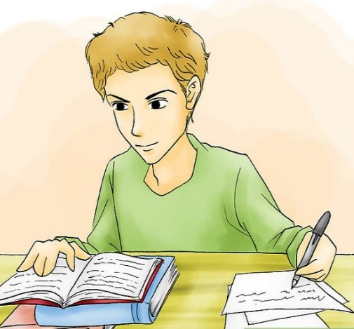
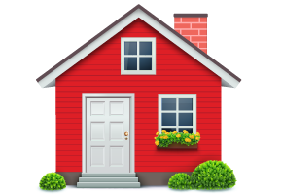
Homework
Write short paragraphs about Greenhouse Effect.

